Slide 1
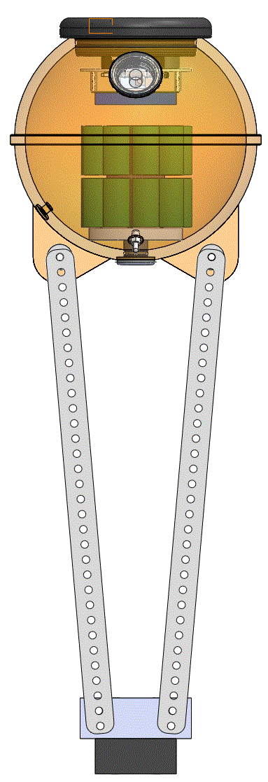
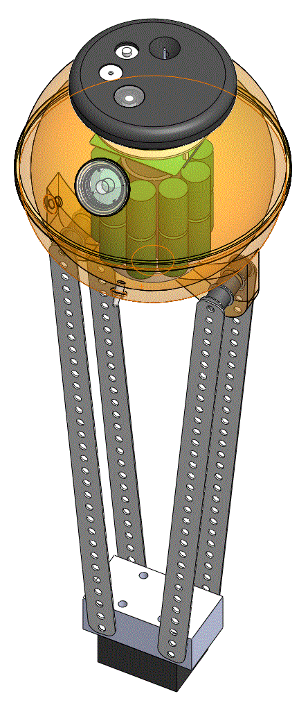
Endcap
Vacuum Port
Fast-Response
Topside Temperature Probe (TTP)
Keller Pressure Sensor
UCAM III Low-Resolution Digital Camera
Skye Instruments Photosynthetically-Activated Radiation (PAR) sensor
30.5 cm (12 in) diameter
side-lug t-float
Slow-Response Sea Surface Temperature (SST) probe
Turner Cyclops 7F Fluorometer
Frame
Counterbalance
Burn-Wire Release

